Slide 1

Altmetric.com in 2014
Notes:
What has happened at Altmetric in the past year?

Slide 2
We’ve learned lots
Notes:
We worked with a lot of people, shared a lot of data, learned a lot in return

Slide 3
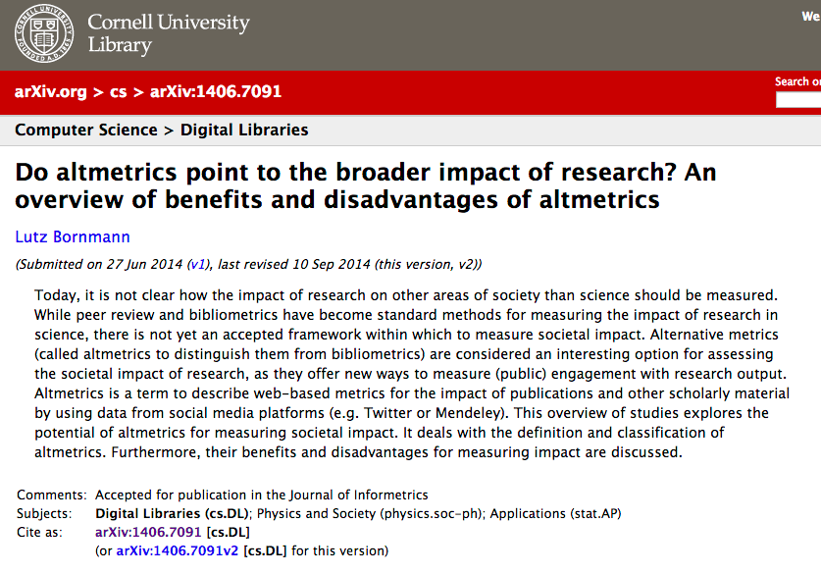
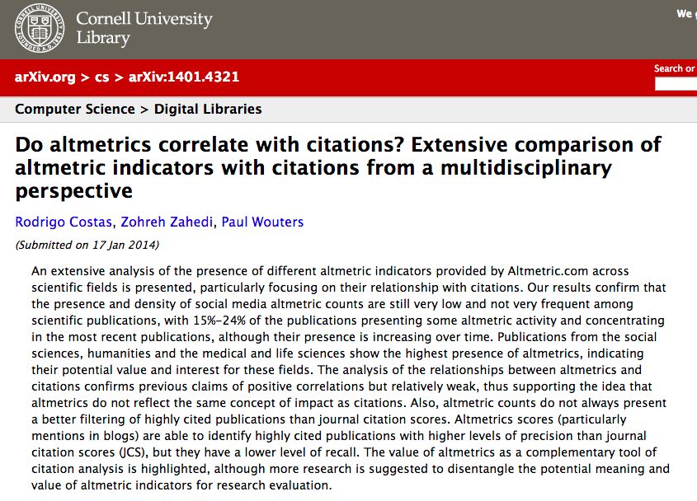
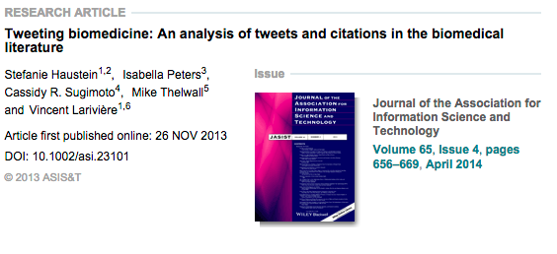
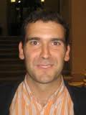
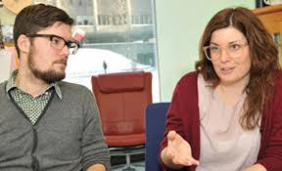


Notes:
We learned fairly definitively that altmetrics don’t correlate with citations – or only weakly.
We learned that you can do better by not looking at all sources at once, but splitting them up (more on that later)
Here are some of the authors – some of them are here. Not going to tell you which author is which paper, ask them in the coffee break!

Slide 4




Notes:
We learned lots about what end users value, and the uses they have for the data

Slide 5


To gauge the overall popularly of the article
87% of respondents strongly agreed or agreed
To discover and network with researchers who are interested in the same area of their work
77% strongly agreed or agreed
To understands a paper’s influence on the scientific community
66% strongly agreed or agreed
To determine what journal to submit their next paper to
60% of respondents strongly agreed or agreed
To determine areas of research to explore
Only 37% of respondents strongly agreed or agreed
Notes:
And article level metrics are definitely not ‘alternative’ any more in STM publishing, which is crazy when you think about the fact that Jason only coined the phrase in 2010

Slide 6

The Evaluation Gap
Notes:
Here’s my biggest epiphany this year: this phrase summed up a lot of what we’d been hearing from institutions. I saw it in a blog post by Paul Wouters, at CWTS

Slide 7
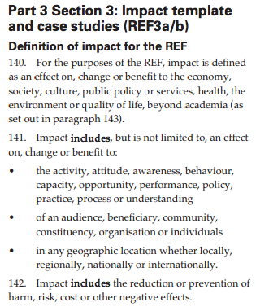
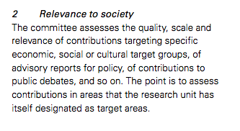
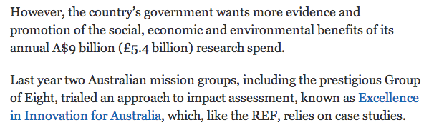
Netherlands
UK
Australia
Notes:
Funders of all kinds are of course concerned primarily with quality of research, but also with broader impacts

Slide 8
What tools, data or practices can help bridge the gap today?
Notes:
Again, it’s not anything new, but it brought a question into focus for us

Slide 9
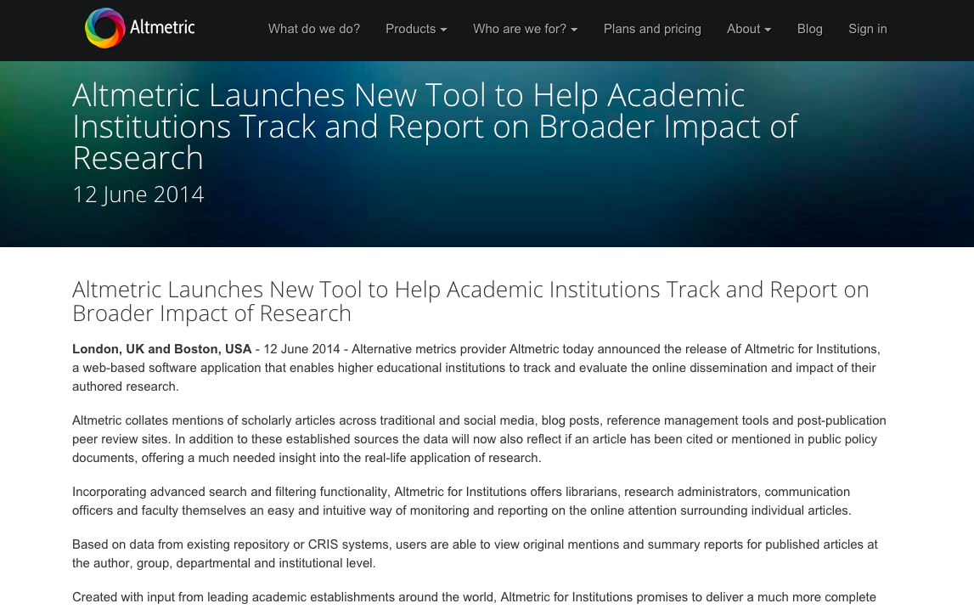





Notes:
We worked with many institutions here and abroad on Altmetric for Institutions – Cambridge, Melbourne, around half a dozen others big and small

Slide 10
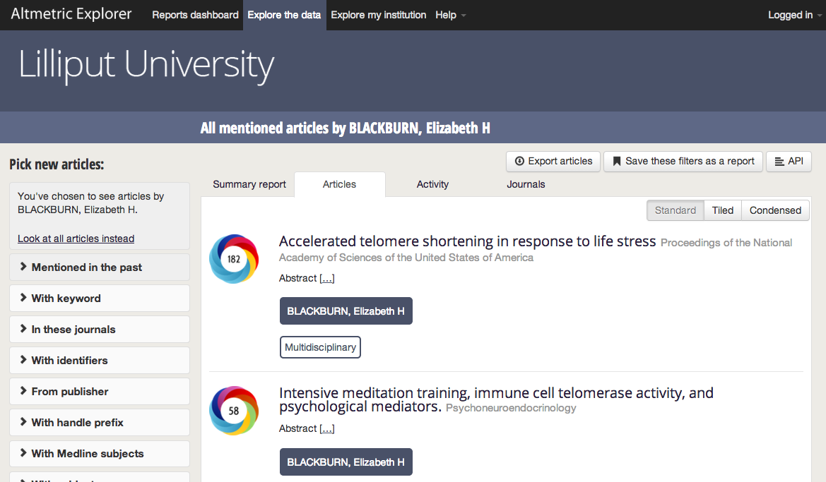
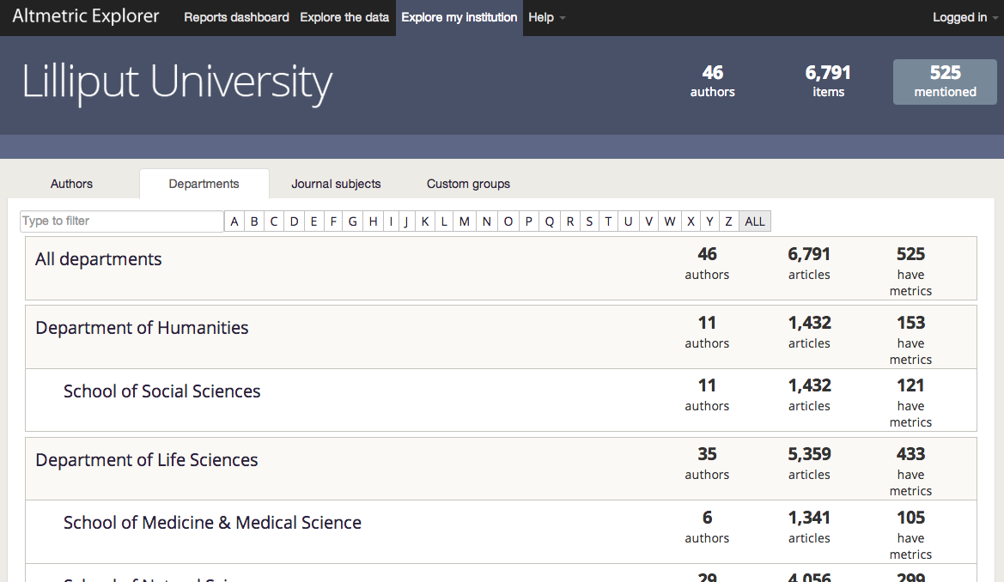
Browsing by author
Browsing by department
Notes:
Allowing aggregation of metrics at institutional, author, departmental level

Slide 11
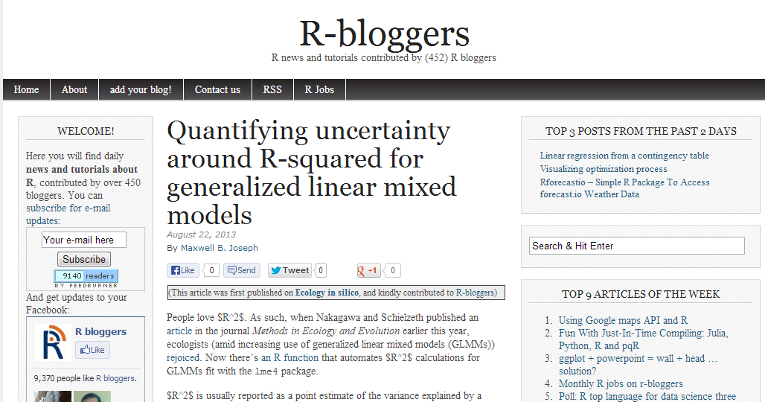
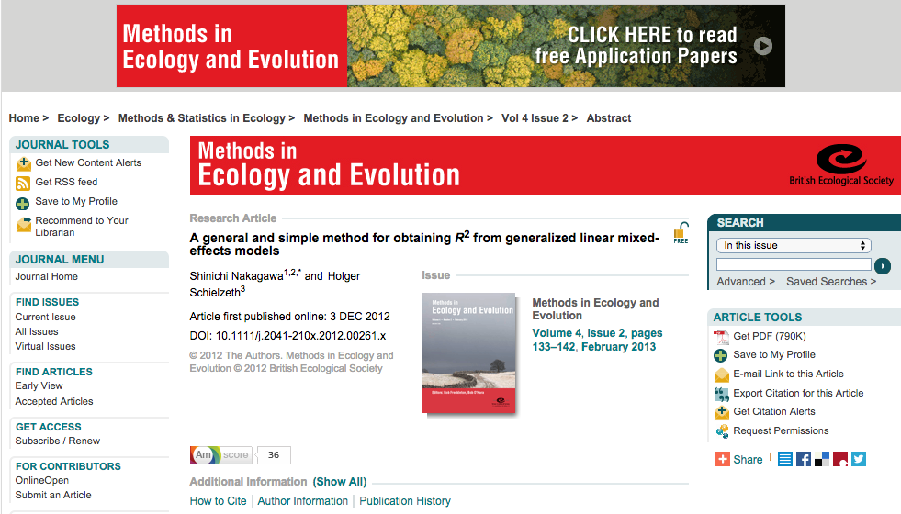

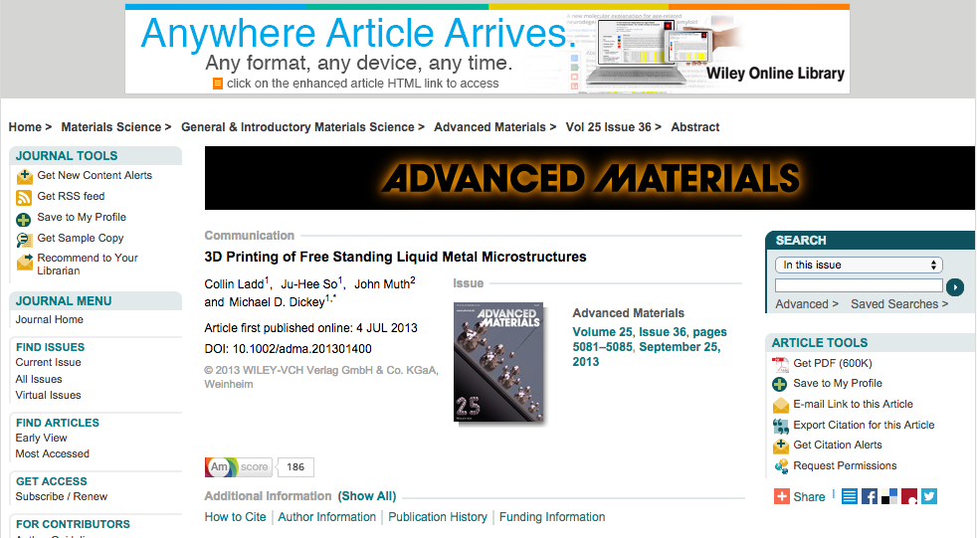
Underlying this… the data
Blogs, reviews, comments
Including Faculty of 1000, PubPeer, MathOverflow and the world’s largest curated index of academic blogs.
Newspapers & magazines
International titles, both mainstream and niche.
Social media

Slide 12


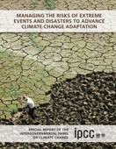
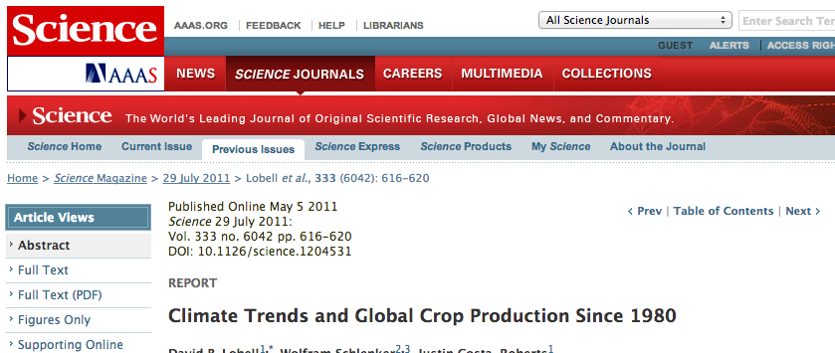
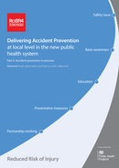
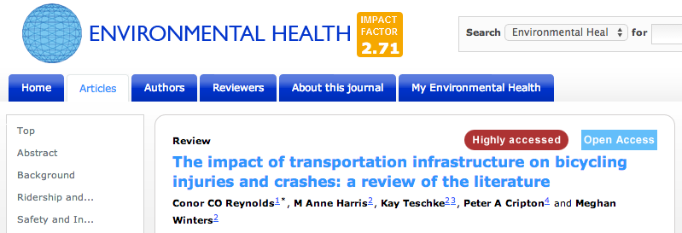
Policy documents
World Health Organization (WHO)
“WHO policy on collaborative TB/HIV activities: guidelines for national programmes and other stakeholders”
Intergovernmental Panel on Climate Change (IPCC)
“Managing the Risks of Extreme Events and Disasters to Advance Climate Change Adaptation”
National Institute for Health and Care Excellence (NICE)
“Delivering Accident Prevention at local level in the new public health system: Road safety policy and links to wider objectives”
Notes:
But the second, even more important part of that is data! Download counts and social media don’t cut it… they are only part of the story. If you’re serious about using altmetrics for evaluation gap then you need to go beyond this. Why we did a big push on news, why we continue to spend a lot of time on policy documents
And that’s only the start – there are lots of exciting data sources that we want to talk to people about, that authors really care about, that are clear indicators of a paper’s influence.

Slide 13
What we’ll keep working on: data that is
Auditable
Meaningful
Presented in context
Notes:
It’s this – great, auditable, useful data – that remains our focus, and what we see as our core competency. This is what we’ll be continuing to deliver in 2015.

Slide 14



Notes:
We’re really excited by the work done by people like Mike Taylor, and Heather Piwowar’s 31 flavours of research impact blog post from a couple of years back.
It’s clear that articles have different ‘flavours’ of impact, as well as the sources themselves. We’re excited to be involved in figuring out standard, cross platform ways of splitting the data like this within initiatives like the NISO standards project and Snowball metrics.

Slide 15
Thanks!

